Slide 1
CS010 602: Internet Computing

Slide 2
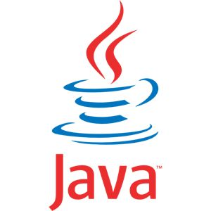
Birth of Java
C Syntax
C++ OOP Concept

Slide 3
Birth of C Language
Problems with FORTRAN,COBOL , Basic
Hardware Revolutions
Software revolution at early 1970s
Invented by Dennis Ritchie in Unix Platform
Powerful, efficient and structured language

Slide 4
Need for C++
Invented on 1979 by Bjarne Stroustrup
To reduce complexity

Slide 5
What revolutions brings the Java in..?
World wide web and Internet

Slide 6
The creation of Java
Conceived by James Gosling, Patrick Naughton, Chris Warth, Ed Frank and Mike Sheridan in 1991 @ Sun Microsystems Inc.
Iniatially called as Oak and renamed as Java in 1995.
Platform independent language for consumer electronic equipments

Slide 7
Java Programs
Applications- runs under an OS
Applets- Designed to be transmitted over the internet and executed by java compactable browsers
Applets are dynamic and intelligent

Slide 8
Java’s magic: The Byte code
The o/p of a java code is a byte code
Byte code is highly optimized set of instructions designed to be executed by the Java run time called Java Virtual Machine(JVM)
JVM will differ from platform to platform

Slide 9
Java Security
Java can guard against viruses and Trojan horses
Java Run time limits the java program.

Slide 10
Java Features
Simple
Java inherits c/c++ syntax and oops concepts
Migration from c/c++
Many confusing concepts/complexities of c/c++ are omitted(eg. Pointers….)
Small number of clearly defined ways to accomplish a task.

Slide 11
Object Oriented- Java is pure oo language
Robust-ability to develop reliable programs
Memory Management and exception Handling
MultiThreaded-
Architectural Neutral-
“Write once, run anywhere anytime forever”
Interpreted and High Performance-
Byte code is interpreted and compiled to native machine code by Just in time compiler
Distributed- (RMI)
Dynamic- (run time type identification)

Slide 12
Object Oriented Programming
Object-oriented programming (OOP) is a programming paradigm that represents concepts as "objects" that have data fields (attributes that describe the object) and associated procedures known as methods. Objects, which are instances of classes, are used to interact with one another to design applications and computer programs

Slide 13
Abstraction
hiding away the implementation details.
Working of a car.
Hierarchical Abstraction

Slide 14
Three OOP Principals
Encapsulation: binds together the code and the data it manipulates and keeps both safe from outside interference and misuse.
A well defined interface to access the code & data.
Public & Private

Slide 15
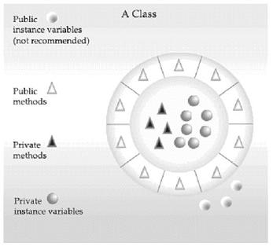

Slide 16
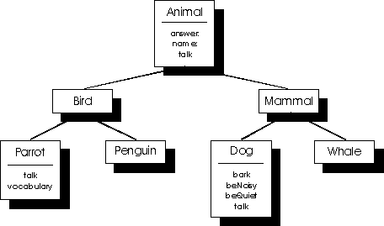
Inheritance
One object properties of another objcet

Slide 17
Polymorphism
An object may behave differently at different time
OR
One interface can be used for a general class actions
Eg: ABS

Slide 18
How to install java
Google “Download Java Software Development kit(sdk)”
Go to the first link(oracle……)
Choose operating system(Xp/Vista/7 & 32 or 64 bit)
Download & install

Slide 19
Creating first program
Open a notepad
Save it in C:\Program Files\Java\jdk1.7.0_09\bin\<filename.java>

Slide 20
My first java program
/* This is simple java program.
Call this file "Example.java".
*/
class Example
{
// Your program begins with a call to main()
public static void main(String args[])
{
System.out.println("This is a simple Java program");
}
}

Slide 21
Entering the program
The file name must be the name of the class that holds main() function with . java extension
Compiling the program
In command prompt -> direct to the bin folder
C:\Program Files\Java\jdk1.7.0_09\bin> javac Example1.java
To Run the program
C:\Program Files\Java\jdk1.7.0_09\bin> java Example1

Slide 22
/* This is simple java program.
Call this file "Example.java".
*/
Multiline Comment
class Example1
{
// Your program begins with a call to main()
public static void main(String args[])
{
System.out.println("This is a simple Java program");
}
}

Slide 23
/* This is simple java program.
Call this file "Example.java".
*/
class Example
{
// Your program begins with a call to main()
public static void main(String args[])
{
System.out.println("This is a simple Java program");
}
}
Keyword class to declare new class; Example is the class name

Slide 24
/* This is simple java program.
Call this file "Example.java".
*/
class Example
{
// Your program begins with a call to main()
public static void main(String args[])
{
System.out.println("This is a simple Java program");
}
}
Single Line Comment

Slide 25
Main()
public static void main(String args[])
{
}
Point where program will begin execution
Public: access specifier used to control the visibility of the class members
Public: members can be accessed outside the class in which it is declared
Private: ????
Main must be declared public since it is called outside the program
Static: allows to call main with out creating an object where it is defined
Void: no return value
String args[] is command line arguments

Slide 26
public static void main(String args[])
{
System.out.println("This is a simple Java program");
}
}
System is the pre defined class that give access to the system
out is the output stream that is connected to the console
println() is the function that displays any string passed to it with a “\n” at the end
Can use print() to display which will not put a “\n” at the end

Slide 27
Data Types
Java is strongly typed language
Every variable
Every expression
every type is strictly defined.
Compiler check every expression, every arguments for type
compatibility.
There are no automatic type conversion of conflicting types

Slide 28
Java Data types
Java defines 8 simple types of data
Integers
a. byte b. short c. int d. long
2. Floating point
a. float b. double
3. Characters
a. char
4. Boolean
a. boolean

Slide 29
Integers
Byte, short, int & long
All are signed positive/negative values

Slide 30
Integers
Name Width(Bits) Range
Long 64 -9,223,372,036,854,775,808 to 9,223,372,036,854,775,807
Int 32 -2,147,483,648 to 2,147,483,647
Short 16 -32,768 to 32,767
Byte 8 -128 to 127
JVM is free to use whatever size it wants

Slide 31
Byte
Syntax : byte b,c;
8 bit
Ranges from -128 to 127
Useful in in working with a stream of data from a network or a file
Or raw binary data

Slide 32
Short
Syntax: short s;
short t;
16 bit
Ranges from -32,768 to 32,767
Least used data type
Bigendian type which is used by 16bit CPUS

Slide 33
Int
Syntax : int i,j;
32 bit
Ranges from -2,147,483,648 to 2,147,483,647
most versatile and efficient

Slide 34
Long
Syntax : long days;
64 bit
Ranges from -9,223,372,036,854,775,808 to 9,223,372,036,854,775,807
Usefull in occasion where int is not enough
Eg: a program that calculates the miles that light will travel in a specified number of days

Slide 35
Floating point types
Used for real numbers that require fractional precision
Eg: squareroot, sine cosine values etc..
Two kinds
Name Width(Bits) Range
double 64 4.9e-324 to 1.8e+308
Float 32 1.4e-045 to 3.4e+038

Slide 36
float
Syntax float hightemp, lowtemp;
32 bit
For single precision values
This gives from 6 to 9 significant decimal digits precision
More faster
For dollars and cents

Slide 37
double
Syntax double pi, r;
64 bits
Double precision
This gives from 15 - 17 significant decimal digits precision
Need to maintain accuracy over many iterative calculations.

Slide 38
Characters
Syntax: char ch1, ch2;
16 bit
Java uses Unicode to represent characters
Unicode defines fully international character set that can represent all of the characters found in all human languages
Eg: Latin, Greek,Arabic etc…
Range 0 to 65,536(no negative values);

Slide 39
Escape Sequences
Escape Sequence Description
\ddd Octal character(ddd)
\uxxxx Hexadecimal INISIDE character(xxxx)
\’ Single quote
\” Double Quote
\\ Back Slash
\r carriage return
\n Newline or line feed
\f form feed
\t tab
\b backspace;

Slide 40
Boolean
Syntax: boolean b;
b=false;
b=true;
For logical values

Slide 41
Type conversion
Java automatic type conversion
will take place iff
a. Two type are compactable
b. The destination type > source type
“Widening conversion”
numeric types are compactable
However numeric types are not compactable with char bool etc..

Slide 42
Casting in compactable types
int to byte ???????
“Narrowing Conversion”
Casting has to be done
Syntax : (target type) value;
int a=257;
byte b;
//……..
b=(byte)a; // value of b=a%256(reduced by % of bytes range)

Slide 43
Byte to floating point
Truncation
Decimal part is lost and modulo of bytes range

Slide 44
Automatic Type Promotion
In expressions the intermediate value exceeds the rage of operands
byte a=40, b=50, c=100;
int d=a*b/c
a*b exceeds the range of byte
Java automatically promotes byte or short to int

Slide 45
byte b=50;
b=b*20 // Compiler error
byte is promoted to int during evaluation but promoted result must be stored in int.

Slide 46
Type promotion rules
All byte and short values are promoted to int
If one operand is long then the whole expression is promoted to long
If one operand is float then the whole expression is promoted to float
If one operand is double then the whole expression is promoted to double

Slide 47
Arrays
Collection of homogenous elements stored in adjacent locations
Arrays can be of any type and dimensions
Array elements can be accessed using an index

Slide 48
1 D array
Declaring an array
Syntax: type var-name[];
Eg: int month_days[];
This will declare the array. But no allocation is done
Allocating an array
Synatx: var-name=new type[size];
month_days=new int[12];
Elements allocated using new will be automatically initialized to
zero.(Robust??)
All array index starts at zero

Slide 49
Accessing an array
class arrays
{
public static void main(String arags[])
{
int i=0;
int month_days[];
month_days=new int[12];
month_days[0]=1;
month_days[1]=2;
month_days[2]=3;
month_days[3]=4;
month_days[4]=5;
for(i=0;i<5;i++)
System.out.println(month_days[i]);
}
}

Slide 50
Array Intialization
class arrays
{
public static void main(String arags[])
{
int i=0;
int month_days[]={1,2,3,4};
for(i=0;i<4;i++)
System.out.println(month_days[i]);
}
}

Slide 51
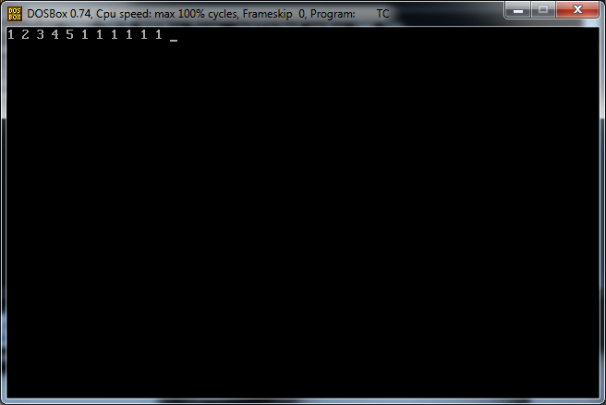
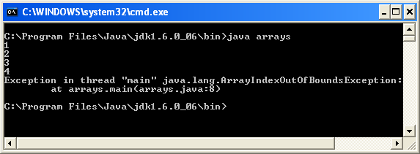
Java runtime strictly checks you don’t try to store/refer any location out of bounds. This run time check is not provided by c/c++(robust???)
#include<stdio.h>
#include<conio.h>
void main()
{
int a[5]={1,2,3,4,5};
int i;
clrscr();
for(i=5;i<=10;i++)
a[i]=1;
for(i=0;i<=10;i++)
printf("%d",a[i]);
getch();
}
class arrays
{
public static void main(String arags[])
{
int i=0;
int month_days[]={1,2,3,4};
for(i=0;i<6;i++)
System.out.println(month_days[i]);
}
}

Slide 52
Write a java program to declare a double array num and initialize with the following values
10.1, 11.2, 12.3, 13.4, 14.5
Find the averge

Slide 53
class average
{
public static void mian(String args[])
{
double num[]={10.1,11.2,12.3,13.4,14.5};
int i;
double result=0;
for(i=0;i<5;i++)
result=result+num[i];
System.out.println(result/5);
}
}

Slide 54
Multi Dimensional Arrays
Array of arrays
Syantx : type array-name[][]=new type[row][col]
Eg: int towD[][]=new int[4][5];
Right index determines column
[0][0] | [0][1] | [0][2] | [0][3] | [0][4]
Left index determines row
[1][0] | [1][1] | [1][2] | [1][3] | [1][4]
[2][0] | [2][1] | [2][2] | [2][3] | [2][4]
[3][0] | [3][1] | [3][2] | [3][3] | [3][4]

Slide 55
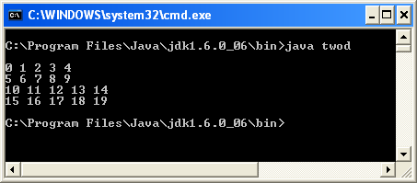
class twod
{
public static void main(String args[])
{
int two[][]=new int[4][5];
int i,j,k=0;
for(i=0;i<4;i++)
for(j=0;j<5;j++)
{
two[i][j]=k;
k++;
}
System.out.print("\n");
for(i=0;i<4;i++)
{
for(j=0;j<5;j++)
{
System.out.print(two[i][j] + " ");
}
System.out.print("\n");
}
}
}

Slide 56
Manual Memory Allocation
Specify the rows. Columns can be allocated manually later.
int num[][]=new int[4][];
num[0]=new int[1];
num[1]=new int[2];
num[2]=new int[3];
num[3]=new int[4];

Slide 57
[0][0]
[1][0] | [1][1]
[2][0] | [2][1] | [2][2]
[3][0] | [3][1] | [3][2] | [3][3]

Slide 58
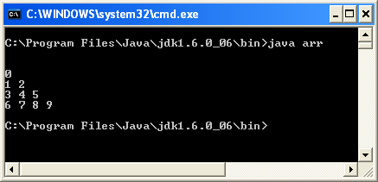
class arr
{
public static void main(String arags[])
{
int num[][]=new int[4][];
num[0]=new int[1];
num[1]=new int[2];
num[2]=new int[3];
num[3]=new int[4];
int i,j,k=0;
for(i=0;i<4;i++)
for(j=0;j<i+1;j++)
{
num[i][j]=k;
k++;
}
for(i=0;i<4;i++)
{
for(j=0;j<i+1;j++)
{
System.out.print(num[i][j]+ " ");
}
System.out.print("\n");
}
}
}

Slide 59
Initializing Multi Dimensional Array
Double m[][]={
{1.1,2.1,3.1,4.1},
{2.1,2.2,2.3,.2.4}
};

Slide 60
Alternate Array Declaration
Synatx: type[] var-name;
Int[] a1=new int[12];
Char[][] w=new char[4][5];

Slide 61
String
It is not simple type.
String is an object of the type/class string

Slide 62
Operators
Operator | Result
+ | Addition
- | Subtraction(Also Unary Minus)
* | Multiplications
/ | Division
% | Modulus
++ | Increment
+= | Addition Assignment
-= | Subtraction ‘’
*= | Multiplication ,,
/= | Division ,,
%= | Modulus ,,
-- | Decrement

Slide 63
Modulus Operator
Returns the remainder of the division
It can be applied to floating point as well as integers(in c/c++ only applicable to integers)

Slide 64
Increment and decremnet
Op++/ ++op
Op--/--op
x=42;
y=++x;
a=40;
b=a++;

Slide 65
The Bitwise Operators
Operator | Result
~ | Bitwise Unary NOT
& | Bitwise AND
| | Bitwise OR
^ | Bitwise Exclusive OR
>> | Shift Right
>>> | Shift Right Zero Fill
<< | Shift Left
&= | Bitwise AND Assignment
|= | Bitwise OR ,,
^= | Bitwise Excusive OR ,,
>>= | Shift right ,,
>>>= | Shift right zero fill ,,
<<= | Shift left ,,

Slide 66
Binary Representation in Java
byte b=42;
2^1+2^3+2^5
2+8+32=42
2^7 2^6 2^5 2^4 2^3 2^2 2^1 2^0
0 | 0 | 1 | 0 | 1 | 0 | 1 | 0

Slide 67
Each Java data type for representing integers is signed:
left most bit 0 means positive, left most bit 1 means negative

Slide 68
Representing Negative numbers
Java uses 2’s complement encoding
Negative numbers are represented by
a. inverting 1 to 0 and vice versa
b. add 1 to the result
Byte b=-42;
42 is represented as 00101010
Inver 1s and zeros =11010101
Add 1 to the result 11010101+
1
Result= 11010110

Slide 69
Java Byte Data Types
Decimal | 8 bit Binary | invert | add 1 for Twos Complement | Decimal
0 | 0000 0000 | - | - | -
+1 | 0000 0001 | 1111 1110 | 1111 1111 | -1
+2 | 0000 0010 | 1111 1101 | 1111 1110 | -2
+3 | 0000 0011 | 1111 1100 | 1111 1101 | -3
+4 | 0000 0100 | 1111 1011 | 1111 1100 | -4
+5 | 0000 0101 | 1111 1010 | 1111 1011 | -5
¯ |  |  |  | ¯
124 | 0111 1100 | 1000 0011 | 1000 0100 | -124
125 | 0111 1101 | 1000 0010 | 1000 0011 | -125
126 | 0111 1110 | 1000 0001 | 1000 0010 | -126
127 | 0111 1111 | 1000 0000 | 1000 0001 | -127
- | - | - | 1000 0000 | -128

Slide 70
To decode
Invert all 1s and 0s
Add 1 to the result
eg:
-42= 11010110
Inver all 1s and zeros= 00101001 +
Add 1 1
Result=00101010

Slide 71
A | B | A|B | A&B | A^B | ~A
0 | 0 | 0 | 0 | 0 | 1
1 | 0 | 1 | 0 | 1 | 0
0 | 1 | 1 | 0 | 1 | 1
1 | 1 | 1 | 1 | 0 | 0

Slide 72
The Left Shift
Syntax: value<<num;
Shifts all the bits in a value to the left a specified number of times
For each shift a high order bit is shifted out and a zero is brought in on the right

Slide 73
The right shift
Syntax: value>>num;
Shifts all the bits in a value to the right a specified number of times
For each shift a low order bit is shifted out and a zero is brought in on the left
But the signed bit will not be changed to keep the sign

Slide 74
Unsigned right Shift >>>
Sometimes it is not required to keep the sign
Eg: pixel values
In >>> the bit position will not be preserved as in >>

Slide 75
Bitwise operator Assignment
Combines the assignment and bit wise operators
a>>=4 ie a=a>>4
a|=b ie a=a|b

Slide 76
Relational Operator
To determine relation ship that one operand has to the other
== , !=, >, <, >=, <=
Can be used with int,float,char and boolean
Result is a boolean

Slide 77
Boolean Logical Operators
Operator Result
& Logical AND
| Logical OR
^ Logical XOR
|| Short circuit OR
&& Short Circuit AND
! Logical Unary NOT
&= AND assignment
|= OR Assignment
^= XOR Assignment
== Equal to
!= Not Equal to
?: Ternary if then else

Slide 78
A | B | A|B | A&B | A^B | !A
FALSE | FALSE
TRUE | FALSE
FASLE | TRUE
TRUE | TRUE

Slide 79
Short circuit Logical Operators
Secondary version of Boolean & and | operator
&&
||

Slide 80
Assignment Operator
variable=expression;
Variable must be compactable with expression
= can be used to create chain of assignments
int x,y,z;
x=y=z=100;
Ie z=100

Slide 81
Ternary(Three way) operator
expression1?expression2:expression3;
If expression1 is true then expression2 is evaluated else expression3 will be evaluated
denom==0?0:num/denom;
Ratio= denom==0?0:num/denom;
Write a java program to greatest of two variables using ternary operator

Slide 82
Operator Precedence
DOT OPERATOR
Precedence
1 | () | [] | .
2 | ++ | -- | ~ | !
3 | * | / | %
4 | + | -
5 | >> | >>> | <<
6 | > | >= | < | <=
7 | == | !=
8 | &
9 | ^
10 | |
11 | &&
12 | ||
13 | ?:
14 | = | OP=

Slide 83
Control Statements
Cause the flow of execution
3 categories
Selection
Iteration
Jump

Slide 84
Selection Control Statement
Allows to choose different paths of execution based on o/p of an expression or state of a variable
according to run time conditions

Slide 85
if
if(condition)
statement1;
else
statement2;
Each statement may be single or compound enclosed in curly
Brackets
Condition is an expression that returns a boolean value
Else clause is optional
int a,b,c;
if(a>b)
c=a;
else
c=b;

Slide 86
If using a boolean value
boolean flag;
if(flag)
………..
else
………..

Slide 87
Nested if
if(i==10)
{
if(j<20)
a=b;
if(k>100)
c=d;
else a=c;
}
else
a=d;
An else will always refer to an nearest if in the same block

Slide 88
If-else-if ladder
if(condition)
statement;
else if(condition)
statement;
.
.
else
statement;

Slide 89
Executed from the top down
As soon as one if is found true the statement(s) will be executed and the rest is bypassed
If none is true statement(s) in else will be executed

Slide 90
Switch Statement
Multi way branch statement based on value of an expression
switch(expression)
{
case value1:
//statement sequence
break;
case value 2:
// statement sequence
break;
.
.
case value n:
// statement sequence
break;
default:
//statement sequence
}

Slide 91
Expression must be type byte,short,int or char
Case statement must betype compactable with the expression
Case value must be unique literal(only constant not a variable)
Duplicate case values are not allowed

Slide 92
working
Value of case statement is compared with expression
If a match found the sequence of statements are executed in that case
If no match found the default statements are executed
If there is no default then no action will take place
If a break is encountered then it will come out of switch statement block
Break is optional. If break is omitted then execution will continue to next case

Slide 93
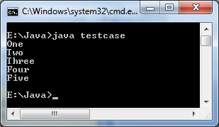
class testcase
{
public static void main(String args[])
{
int i;
for(i=1;i<6;i++)
switch(i)
{
case 1:
System.out.println("One");
break;
case 2:
System.out.println("Two");
break;
case 3:
System.out.println("Three");
break;
case 4:
System.out.println("Four");
break;
default:
System.out.println("Five");
}
}
}

Slide 94
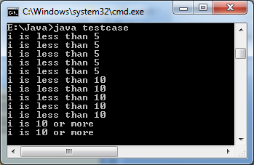
class testcase
{
public static void main(String args[])
{
int i;
for(i=0;i<12;i++)
switch(i)
{
case 0:
case 1:
case 2:
case 3:
case 4:
System.out.println("i is less than 5");
break;
case 5:
case 6:
case 7:
case 8:
case 9:
System.out.println("i is less than 10");
break;
default:
System.out.println("i is 10 or more");
}
}
}

Slide 95
Nested Switch
switch(count)
{
case 1:
switch(target)
{
case 0:
System.out.println(“target=0”);
break;
case 1: // No conflict with the case 1 of the outer switch
System.out.println(“target=1”);
break;
}
break;
case 2:
//……………………………………………………………
}

Slide 96
Comparison with if
Switch can only test for equality whereas if can evaluate any type of boolean expression
No two case statements can be identical in a switch block
Switch statement is more efficient than set of nested ifs
when compiles java compiler inspects each case values and creates a “JUMP TABLE”
This table is used to decide the path of execution
Switch is faster because it can perform equality of case value and expression and both are of same type

Slide 97
Iteration Statements
Loops repeatedly executes the same set of instructions until a termination condition is met
for , while and do- while

Slide 98
while
The most fundamental loop
while(condition)
{
//body of loop
}
Condition can be any boolean expression
Body of the loops is executed as long as the condition is true
Write a java program to initialize an integer array with any ten numbers and print the elements using a while loop

Slide 99
class loop_test
{
public static void main(String args[])
{
int[] a={1,2,3,4,5,6,7,8,9,10};
int i=0;
while(i<10)
{
System.out.println(a[i]);
i++;
}
}
}

Slide 100
Entry control loop
Loop body can be empty
to find the mid point of 100 and 200

Slide 101
class ternary
{
public static void main(String args[])
{
int i=100, j=200;
while(++i<--j);
System.out.println(i);
}
}

Slide 102
do while
Exit control loop
do
{
// body of loop
} while(condition);
Used for menu driven programs
Loop will display the menu once then user gives the choice

Slide 103
For loop
Count control loop
for(initialization;condition;iteration)
{
}
Initialization
Condition
iteration

Slide 104
Declaring loop control variables inside the for loop
Possible to declare the variable inside the initialization portion of for
for(int i=0; i<10;i++)
{
}
Scope of this variable is limited to the for block

Slide 105
Using comma
It is possible to include more than one statement in initialization and iteration part of for
class test_for {
public static void main (String args[])
{
int a,b;
for(a=100, b=200;a<b;a++, b--);
System.out.println(a);
}
}
class test_for {
public static void main (String args[])
{
int a,b;
b=200;
for(a=100;a<b;a++)
{
b--;
}
System.out.println(a);
}
}

Slide 106
Some loop variations
Condition can be any boolean expression
boolean done=false;
int i=0;
for(;!done;)
{
System.out.println(i);
if(i==10)
done=true;
i++;
}

Slide 107
Infinite loop
for(; ;)

Slide 108
Nested loops
for(i=0;i<n;i++)
for(j=I;j<n;j++)
{
//body of the inner loop
}

Slide 109
Jump Statements
Break, continue and return

Slide 110
Break
It terminates a statement sequence in switch
It can be used to exit a loop
It can be used as goto

Slide 111
Break to exit a loop
When break is encountered inside a loop
loop is terminated
control of execution goes to next statement following the loop;
class test_break
{
public static void main (String args[])
{
int i;
for(i=0;i<100;i++)
{
if(i==10)
break;
System.out.println(i);
}
}
}

Slide 112
In case of nested loops break only terminates the inner loop

Slide 113
Break as a form of goto
Java does not have goto statement
Instead break can be used to tell where the execution exactly should resume
Called as labeled break
Syntax break label;
label is a java identifier with a column

Slide 114
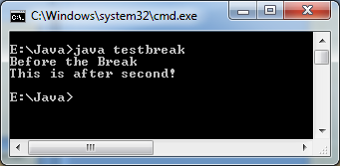
class testbreak
{
public static void main(String args[])
{
boolean t=true;
first:{
second:{
third:{
System.out.println("Before the Break");
if(t)
break second;
System.out.println("Thid wont execute");
}
}
System.out.println("This is after second!");
}
}
}

Slide 115
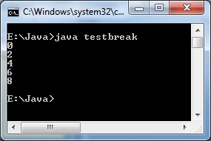
Continue
Continue the loop but by pass the remaining code in the body of loop for the current iteration
class testcontinue
{
public static void main(String args[])
{
for(int i=0;i<10;i++)
{
if(i%2!=0)
continue;
System.out.println(i);
}
}
}

Slide 116
In a while & do while loop the continue will transfer the control to the condition
In for loop continue will take control to iteration portion then to conditional expression

Slide 117
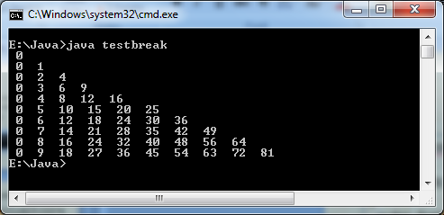
Continue using label
class testcontinue
{
public static void main(String args[])
{
outer :for(int i=0;i<10;i++)
{
for(int j=0;j<10;j++)
{
if(j>i)
{
System.out.println();
continue outer;
}
System.out.print(" "+ i*j + " ");
}
}
}
}

Slide 118
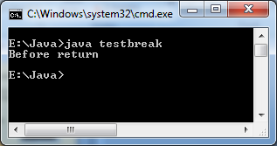
Return
Explicitly return from a method/function to the caller function
Here control is transferred to Java run time system since main is called by Java Run time system
class testreturn
{
public static void main(String args[])
{
boolean t=true;
System.out.println("Before return");
if(t)
return;
System.out.println("This wont execute!");
}
}

